Slide 1
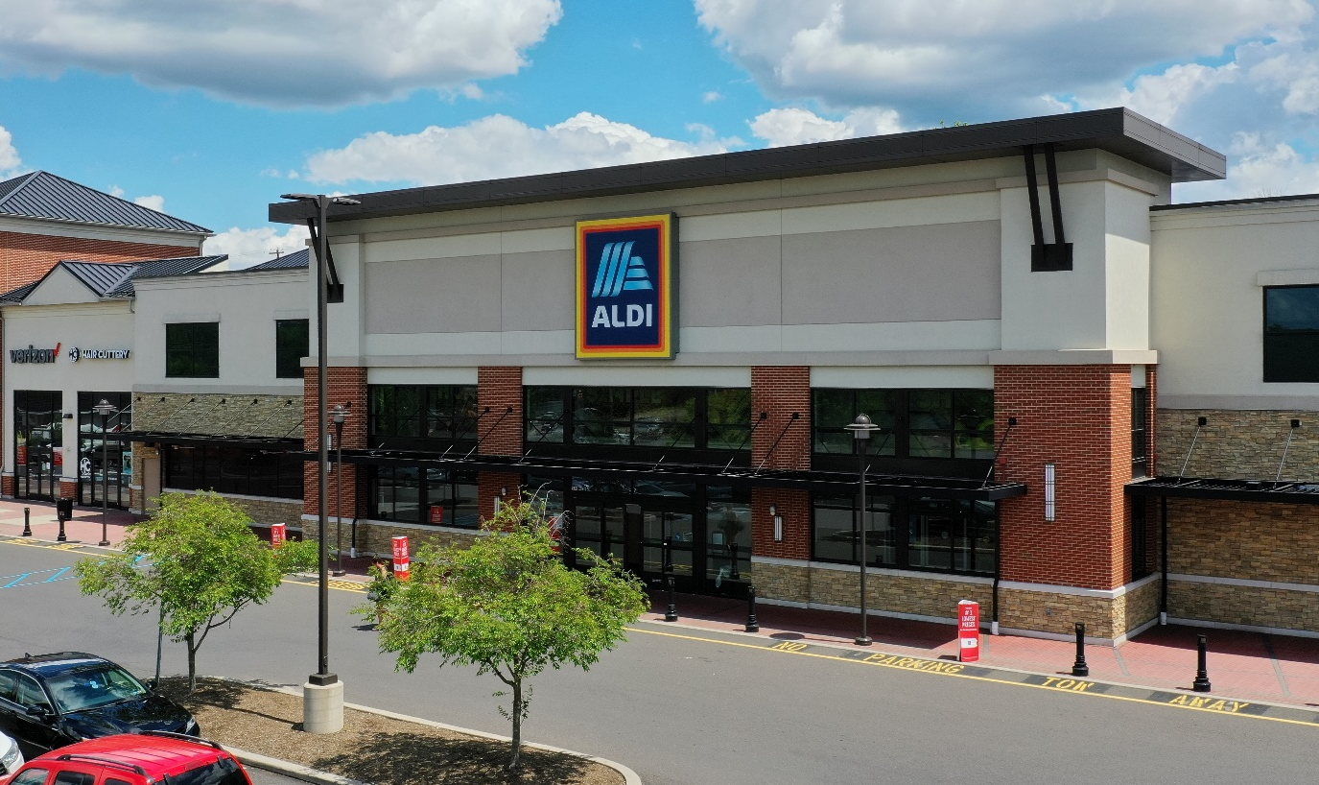
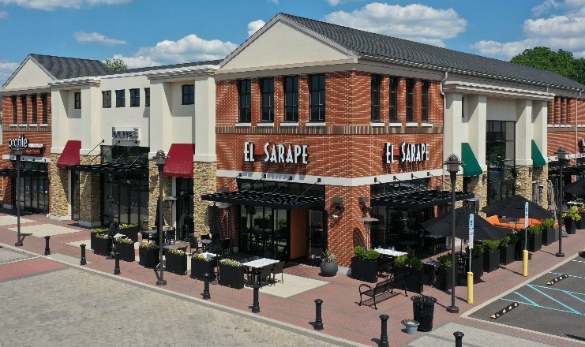
CENTRE SQUARE COMMONS
920-998 Dekalb Pike, Blue Bell, PA 19422
Montgomery County | GLA: ± 87,590 SF
Grocery anchored center with desirable mix of retail and service-oriented tenants
Strategically located at intersection of Dekalb Pike/Rt. 202 and Skippack Pike/Rt. 73 with a combined traffic count of approximately 36,263 v.p.d.
Serves an upscale trade area with high daytime population
Demographics | 1 Mile | 3 Mile | 5 Mile
Population: | 5,428 | 46,183 | 171,975
Avg. HH Income: | $238,199 | $192,864 | $153,625
Households: | 2,078 | 18,546 | 67,359
ARLENE GRAY agray@paramountrealty.com
KRISTI PENNINGTON kpennington@paramountrealty.com
120 North Pointe Blvd., Suite 301, Lancaster, PA 17601
717-569-9373 | paramountrealty.com

Slide 2
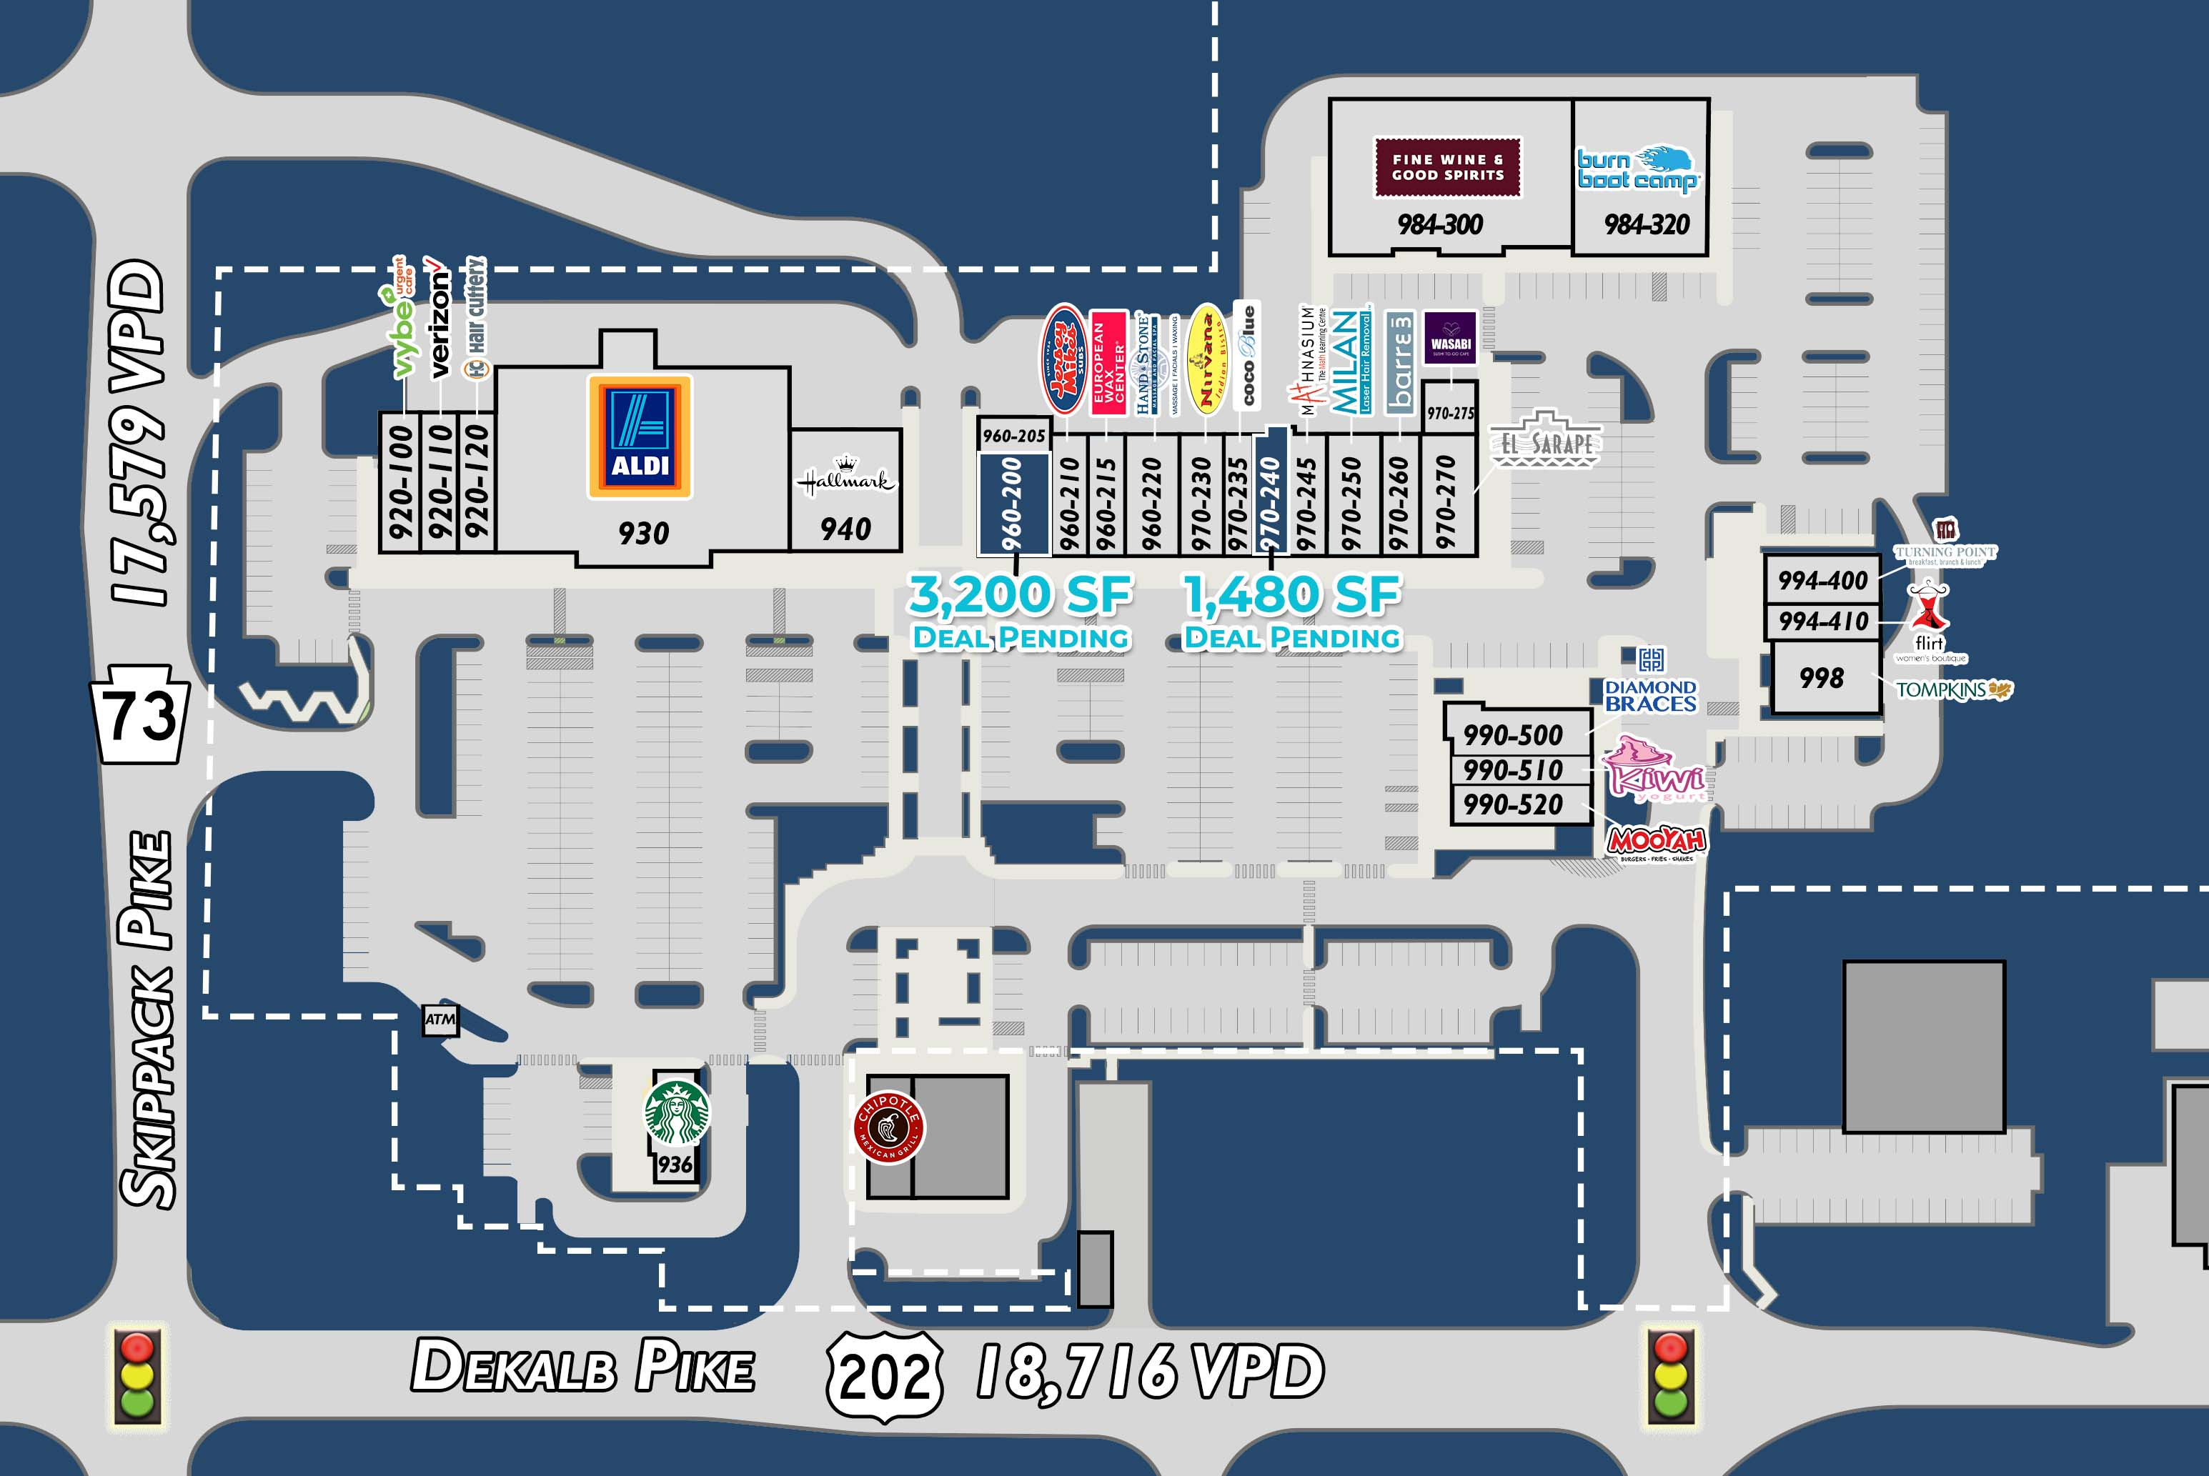
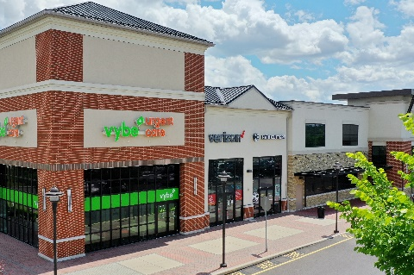
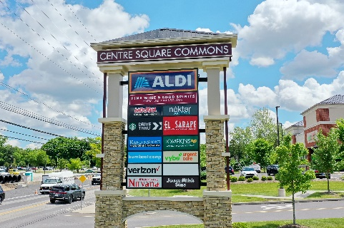
Centre Square Commons
For Lease
Subject To Change
920-100 Vybe Urgent Care 2,800 SF
920-110 Verizon Wireless 1,800 SF
920-120 Hair Cuttery 1,360 SF
930 Aldi 22,450 SF
936 Starbucks 2,000 SF
940 Norman’s Hallmark 5,400 SF
960-200 Deal Pending 3,200 SF
960-205 Static 450 SF
960-210 Jersey Mike’s 1,600 SF
960-215 European Wax 1,477 SF
960-220 Hand & Stone Massage 2,800 SF
970-230 Nirvana Indian Restaurant 1,936 SF
970-235 Coco Blue Nail Salon 1,600 SF
970-240 Deal Pending 1,480 SF
970-245 Mathnasium 1,720 SF
970-250 Milan Laser Hair Removal 2,080 SF
970-260 Barre 3 Yoga 2,000 SF
970-270 El Sarape 2,800 SF
970-275 Wasabi Sushi 983 SF
984-300 Fine Wine & Good Spirits 10,816 SF
984-320 Burn Boot Camp 4,500 SF
990-500 Diamond Braces 2,820 SF
990-510 Kiwi Yogurt 1,400 SF
990-520 MooYah Burgers & Fries 2,145 SF
994-400 Turning Point Restaurant 3,366 SF
994-410 Flirt 1,095 SF
998 Vist Bank 2,500 SF
The information herein (including all faxes pertaining to the same) has been obtained from sources deemed reliable. While we do not doubt its accuracy, we have not verified and make no guarantee, warranty, or representation about it. It is your responsibility to independently confirm it accuracy and completeness and is subject to correction or can be withdrawn without notice.
ARLENE GRAY agray@paramountrealty.com
KRISTI PENNINGTON kpennington@paramountrealty.com
120 North Pointe Blvd., Suite 301, Lancaster, PA 17601
717-569-9373 | paramountrealty.com

Slide 3
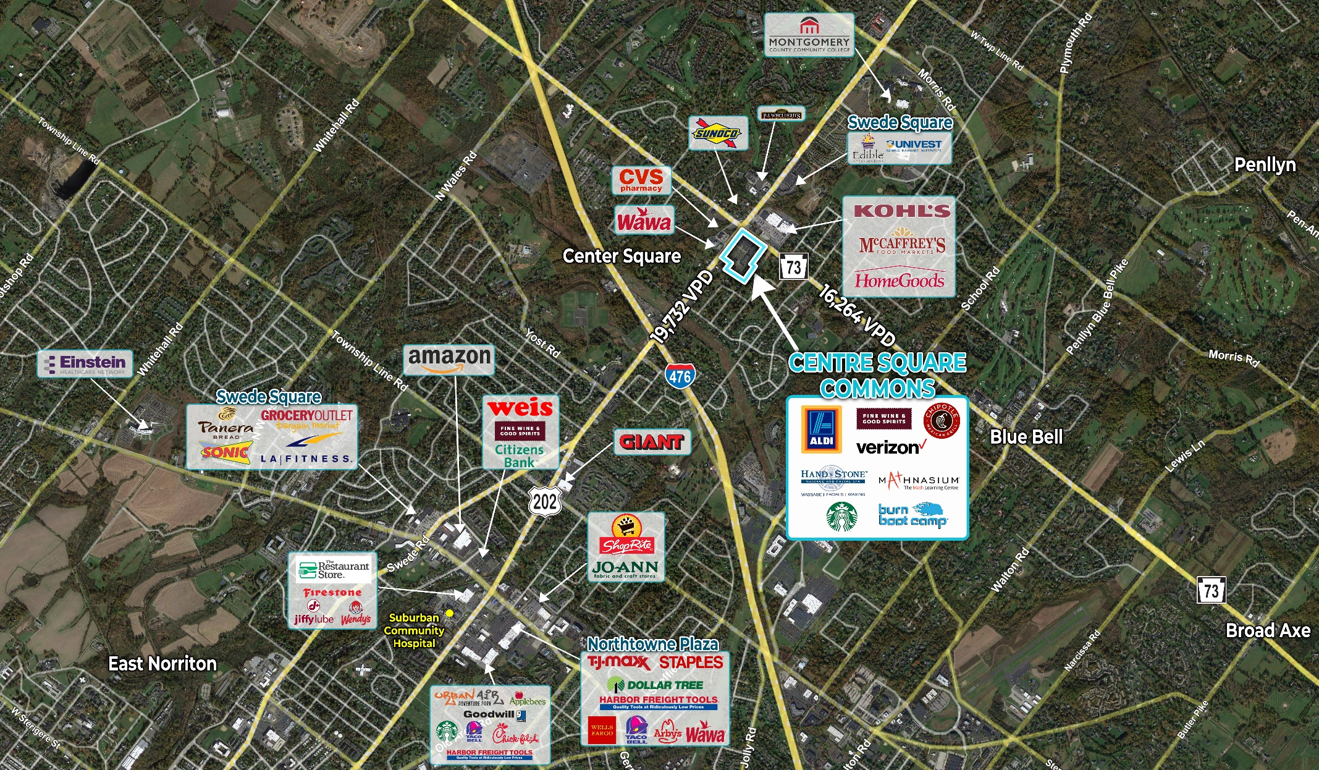
CENTRE SQUARE COMMONS
920-998 Dekalb Pike | Whitpain Township
ARLENE GRAY agray@paramountrealty.com
KRISTI PENNINGTON kpennington@paramountrealty.com
120 North Pointe Blvd., Suite 301, Lancaster, PA 17601
717-569-9373 | paramountrealty.com

